Slide 1
E-DETECT TB
Find and treat models in the Netherlands and UK, transferability to Eastern Europe (Romania and Bulgaria) and options for integrated care delivery
INTEGRATE satellite symposium AIDS 2018,
Amsterdam, the Netherlands
25th July 2018
Gerard de Vries, MD MSc PhD
Consultant KNCV Tuberculosis Foundation
On behalf of the E-DETECT TB project
gerard.devries@kncvtbc.org

Slide 2
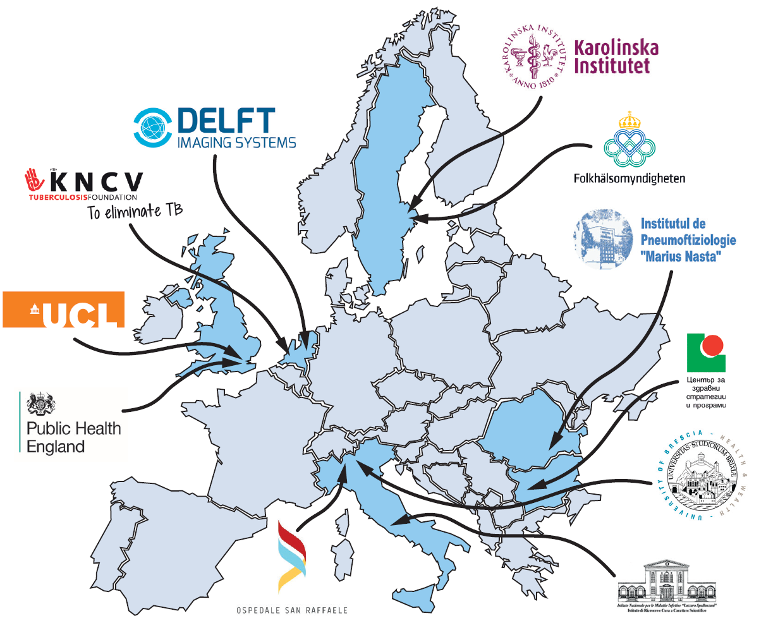
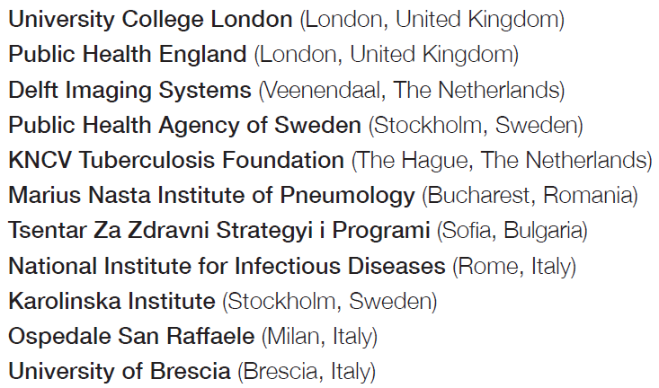

The E-DETECT TB consortium

Slide 3
What is E-DETECT TB about?
“A practical programme of translational research”
It brings partners together, share their experiences and exploit new technologies and advances in knowledge to TB control.

Slide 4
Rotterdam, The Netherlands
In 2001, Rotterdam faced a TB outbreak among drug users and homeless people.
In 2002, start mobile screening activity (+ 4 years financial support from the municipality of Rotterdam)
  Hiring truck/unit with digital x-ray equipment
  Employing an additional nurse to support treatment
Programme features:
Outreach; e.g. screening at night at the prostitution zone
Collaboration with NGOs (e.g. Salvation Army) and other municipal organizations; e.g. methadone programme
One stop shop (at Municipal Public Health Services/GGD)

Slide 5
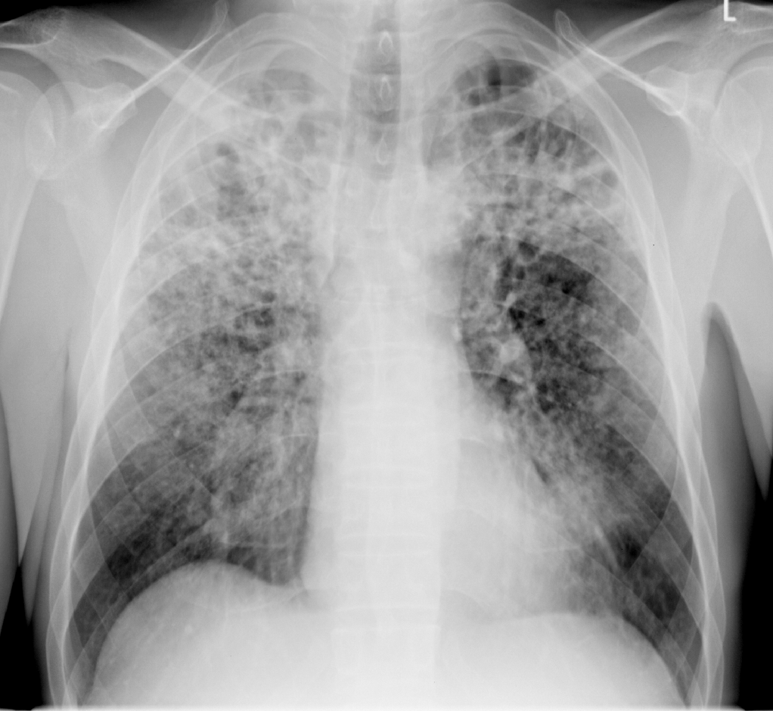
TB among homeless persons and drug users in Rotterdam
de Vries, G, van Hest RA, EJPH, 2005;133-136.

Slide 6
TB among homeless persons and drug users in Rotterdam
Mobile X-ray Screening
de Vries, G, van Hest RAH, Richardus JH, ARJCCM, 2007;201-207.
Notes:
High proportion smear positive
Mandatory isolation
Stopped

Slide 7
London, The United Kingdom
Mobile radiographic screening started in 2005 and had several developments.
  From “Find and Lose” to “Find and Treat”
  Use of peer supporters/educators
  Social care facilities, such as the Olallo house, for 10-15 TB patients to house and receive DOT
  Video-observed therapy (VOT)
  Social science research; economic evaluation
  “People not pathogens” (Al Story); from screening for active TB to screening for latent TB infection and other blood-born viruses (BBVs), vaccination, etc.

Slide 8
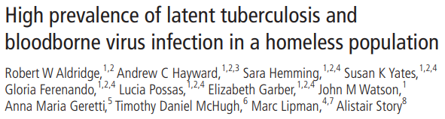
16.5% LTBI
11.9% Hep B; 64% no immunity to Hep B
13.0% Hep C
1.0% HIV
37.0% of those diagnosed with LTBI had also Hep B or Hep C infection

Slide 9


In major urban centres and areas of identified need:
  Offer BBV testing alongside active case-finding using mobile digital radiography
https://www.nice.org.uk/guidance/NG33

Slide 10

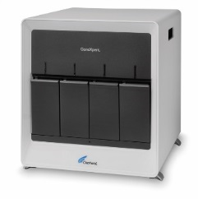

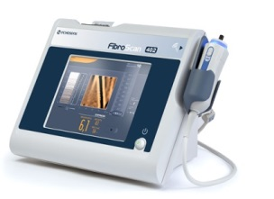

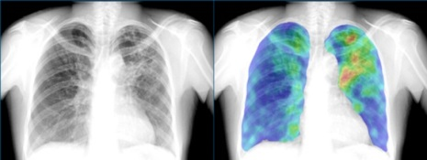
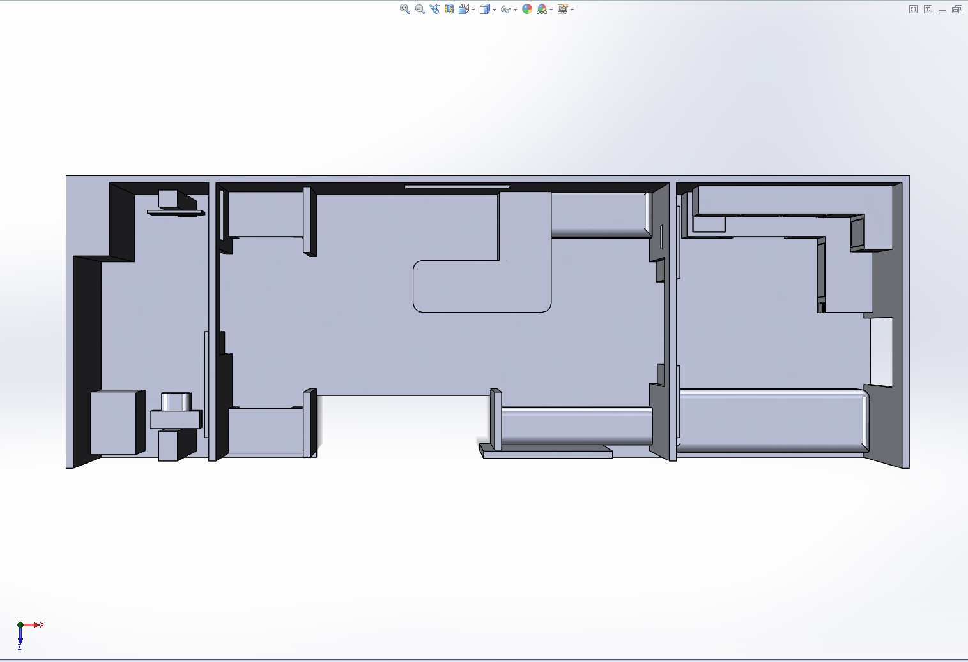
Integrated One-stop-shop screening
Laboratory
Digital X-ray
Reporting station
Waiting area
Reception
Clinical examination

Slide 11
TB in European Union Big Cities Working Group
“Exchange of experience, collaborative research, advocacy and cooperation between different urban TB programmes in the EU will be instrumental to achieving TB control.”
The organisation of annual EU Big Cities meetings was financially supported by the European Centre for Disease Prevention and Control (ECDC), 2010-2015.

Slide 12
WP4 objectives of E-DETECT TB
To ensure early diagnosis in vulnerable populations in Romania and Bulgaria, i.e. in
  Homeless individuals
  Roma population
  People with a history of drug use
  Prisoners
To strengthen care integration using an outreach strategy within the same vulnerable populations in Romania by providing a one-stop “shop” approach.
This will be done by an outreach mobile digital x-ray screening van equipped with automated x-ray reading equipment (CAD4TB) and rapid molecular diagnostics (GeneXpert).

Slide 13
TB patients Romania (2017)
Characteristics | total | prisoners | drug users | homeless
Estimated population | 19.7m | 28,000 | 10,000 | 5,000-15,000
Number of TB cases | 13036 | 107 | 57 | 117
Estimated TB incidence (per 100,000) | 66 | 382 | 570 | 500-1500 (Bucharest)
Urban residence | 44% | 48% | 88% | 69%
Previous history of TB | 20% | 24% | 23% | 45%
HIV infection | 2.2% | 20% | 82% | 5.4%
Drug resistance against rifampicine | 4.6% | 4.6% | 11.8% | 14.0%
Treatment outcome (2016)
- Successful | 81% | 92% | 46% | 62%
- Died | 8.6% | 3.7% | 25.0% | 13.4%

Slide 14
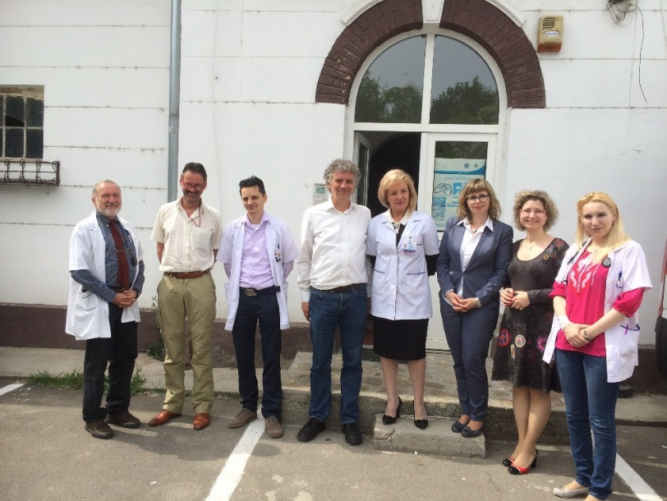
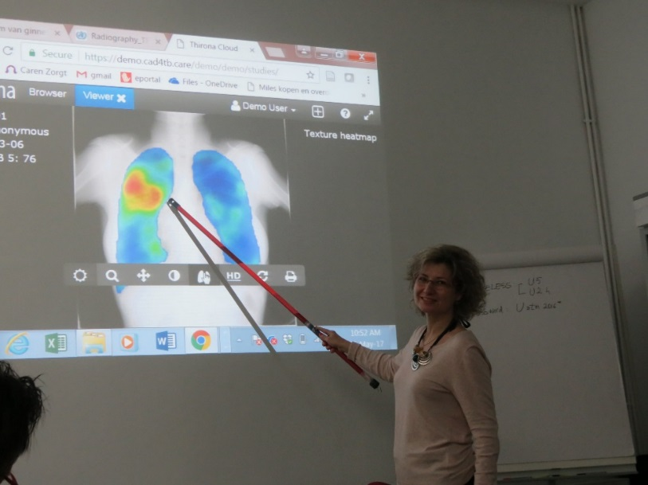
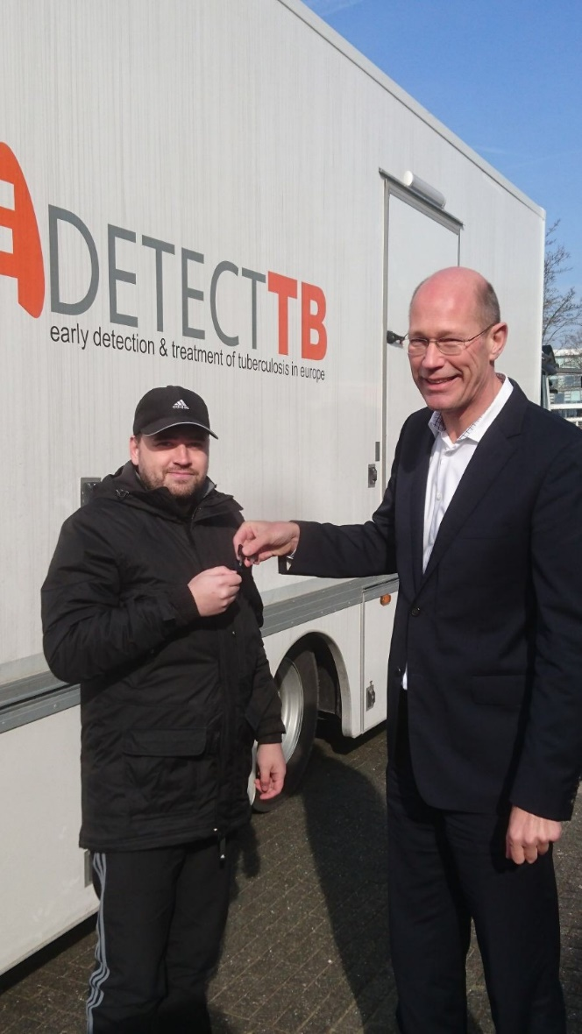
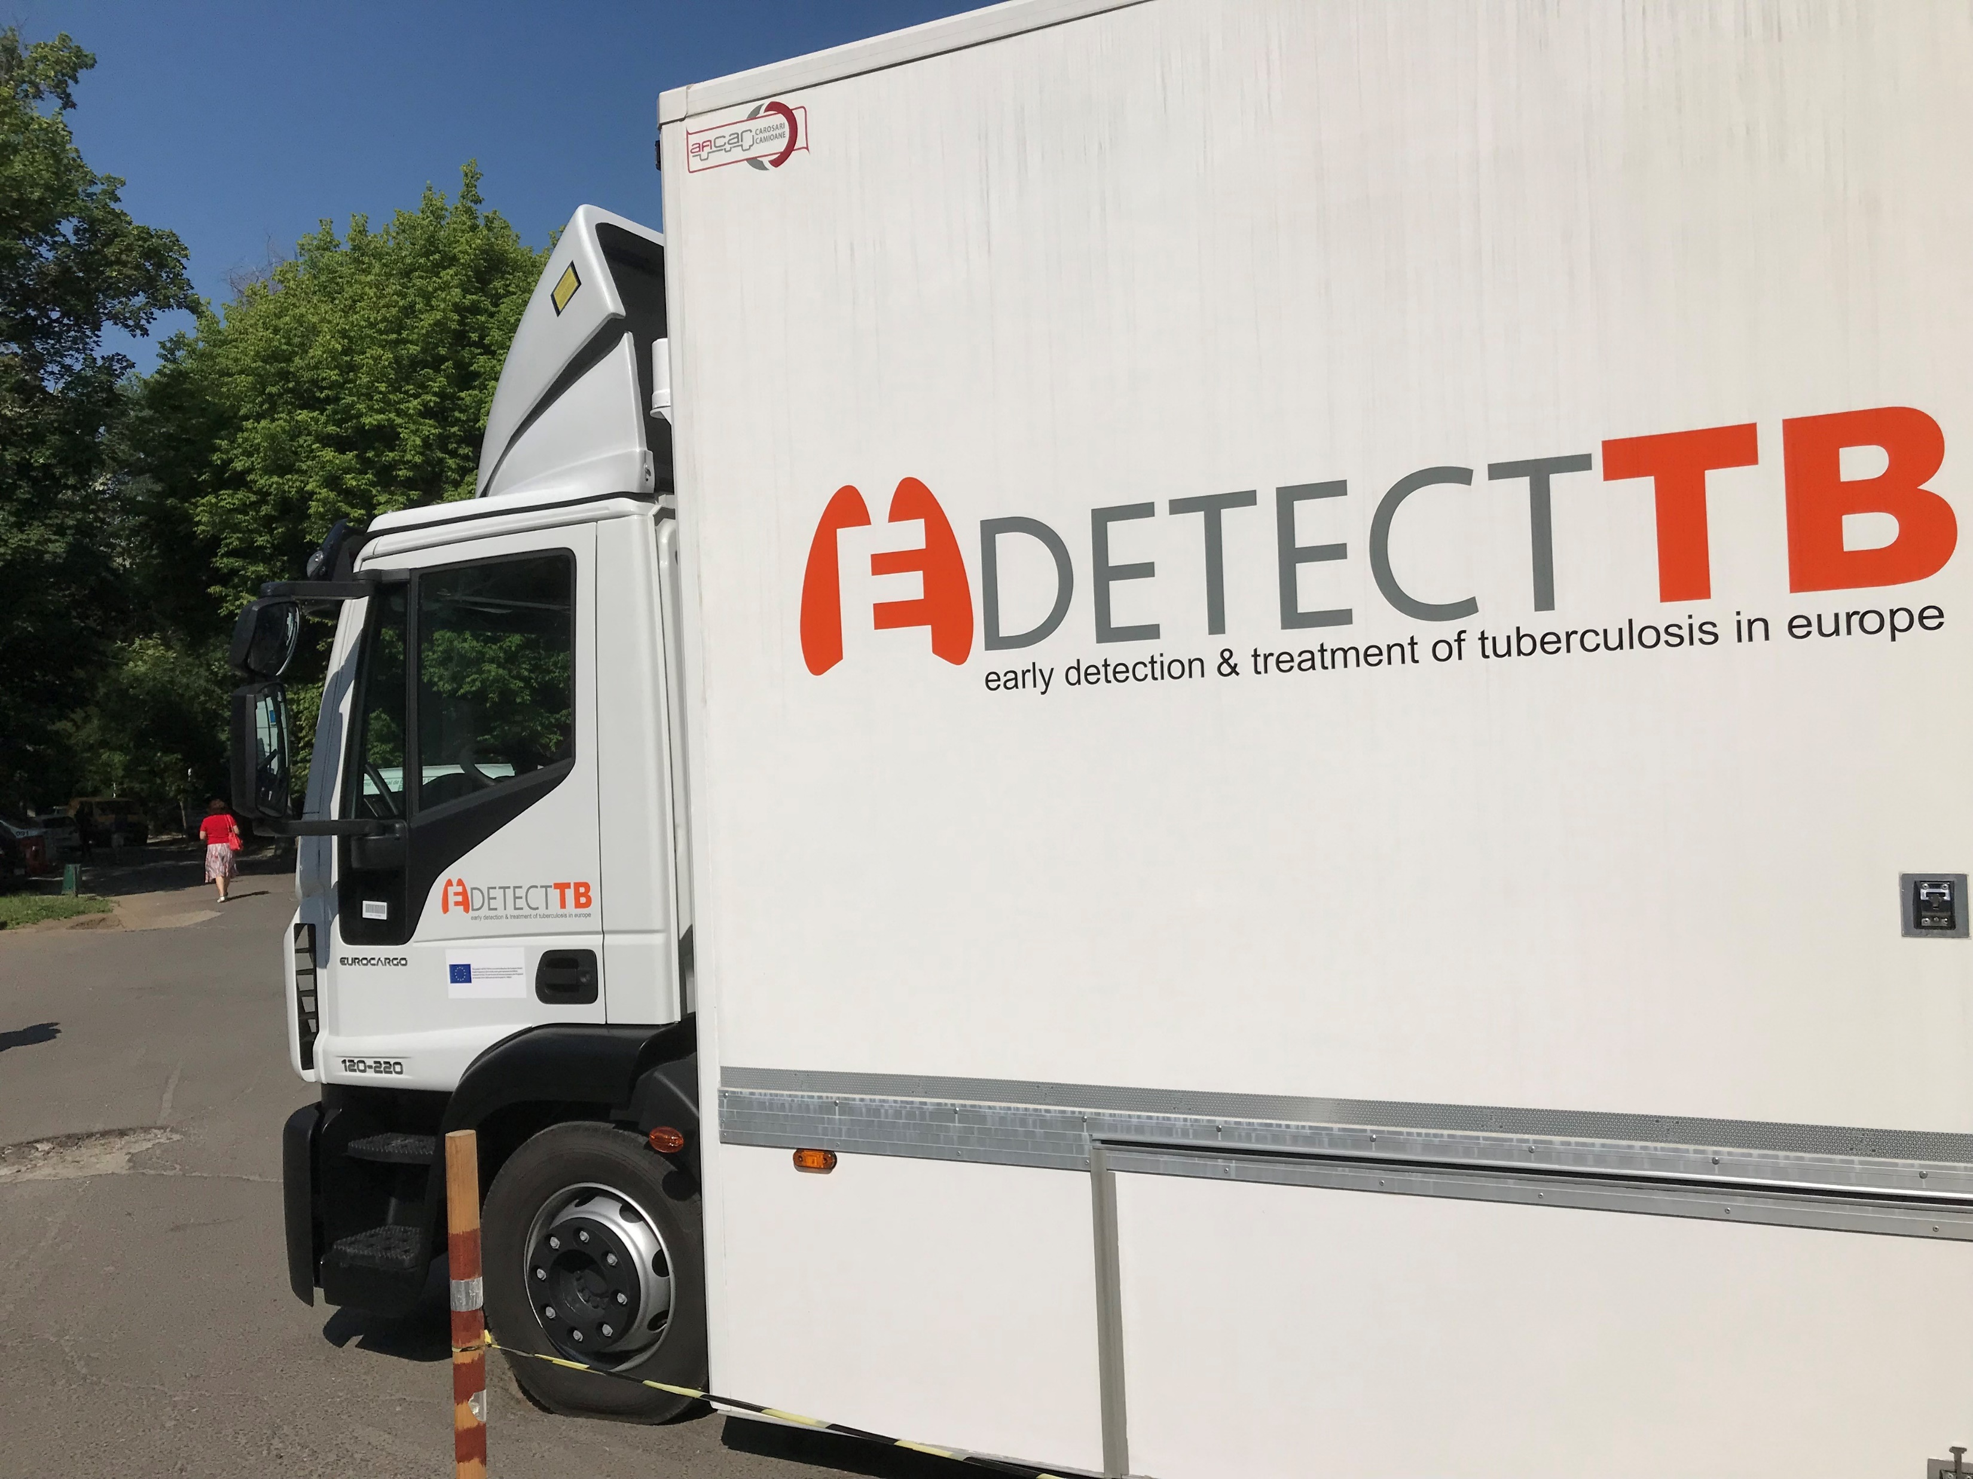
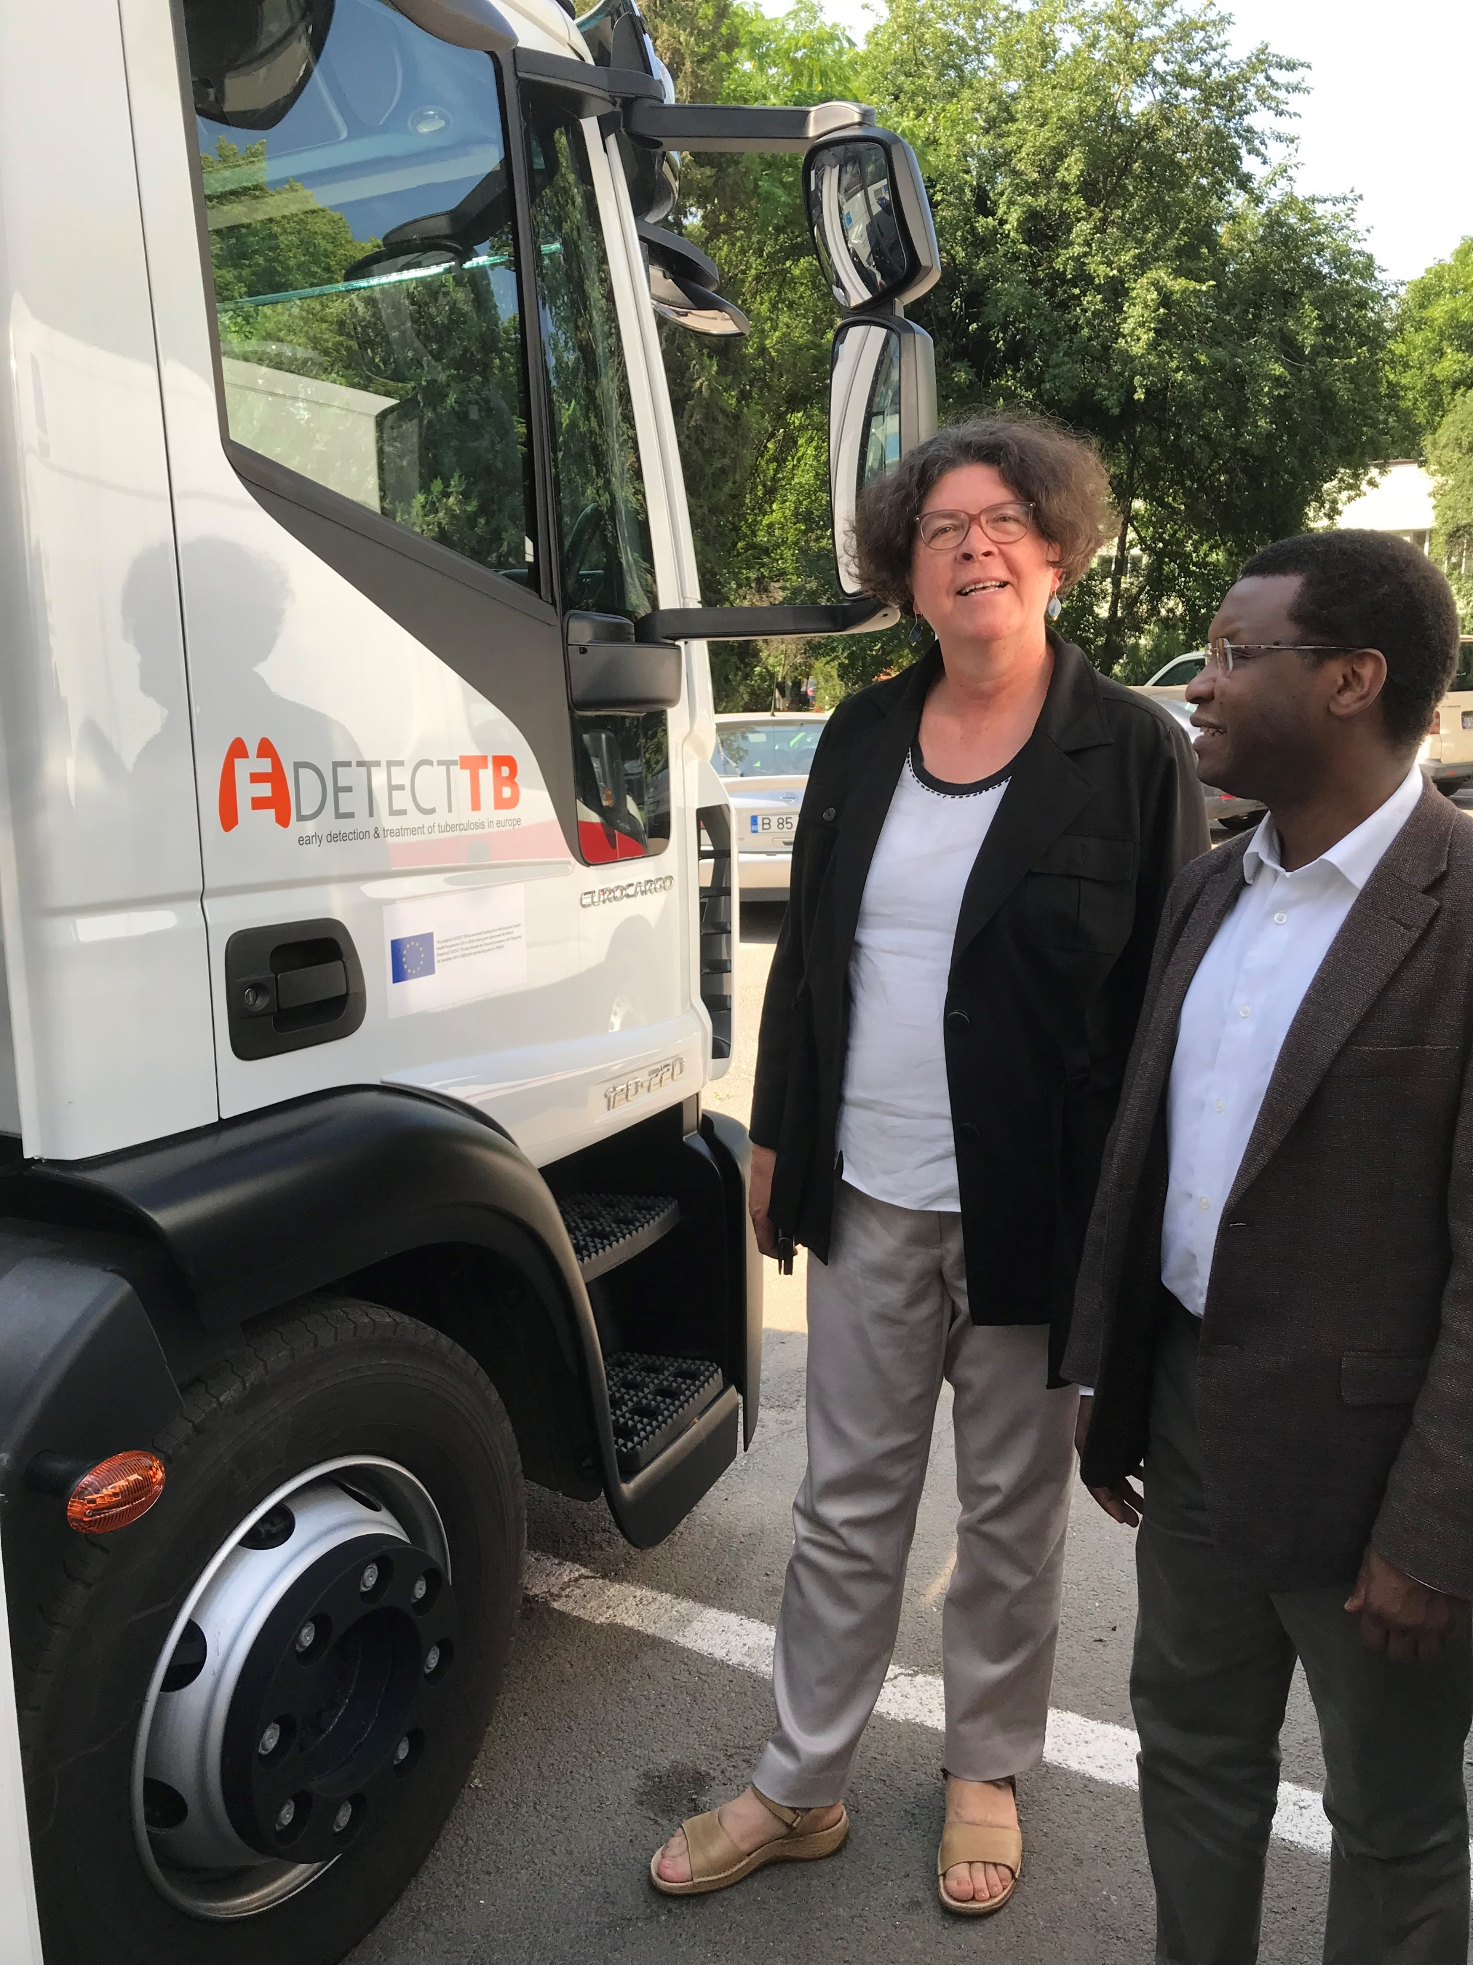

Slide 15
Bucharest, Romania
National Radiation Council approved mobile x-ray set up on 20th July 2018
Ready to start this week!
In 1 year time piloting in Bulgaria

Slide 16










Thank you for listening!

